Slide 1
Monitor and Adapt

Slide 2
Estimate Activities
Manage Iteration
Estimate
End Iteration Checkpoint
Project Management
Plan
Iteration Retrospective
Monitor & Adapt
Report Status
Collect Client Feedback
Close Project

Slide 3



Manage Iteration
Purpose:
  To ensure that the project is running smoothely on a day-to-day basis
Objectives:
  Share information with the team
  Assess project process
  Identify issues that may impede project progress
  Identify issues that need to be raised with the client before the next checkpoint
Activities:
  Conduct daily team meeting
  Perform ongoing iteration management
    Eg. Update issue and risk tracker; update overall plan; monitor progress of stories; manage resources; ensure Continuous Integration is occuring; review and update project metrics and tracking
Output:
  Updated issues and risks
  Updated iteration plan
  ...

Slide 4
Manage Iteration – Best Practices
Only have 1-3 stories in process at one time (per track)
Keep status visible at all times
Check that teams update the Iteration Plan
Testers continuously work with Developers to test functionality
  Make sure stories are being tested as they are completed, first within development environment and then later in integration environment
Make sure developers check in often
Check that peer reviews are happening
Prepare for the next iteration’s stories — ensure requirements are understood; resources, data and people are in place
Update the overall plan, validate appropriate progress to overall goals
Manage risks

Slide 5

End Iteration Checkpoint
Purpose:
  To assess the completion of the iteration and inform the next iteration
Objectives:
  Review accomplishments of the iteration
  Receive feedback from clients
  Collect feedback that will inform planning for next iteration
  Gain approval from the client for what has been delivered in that iteration
  Mark the completion of the iteration
Activities:
  Setup checkpoint logistics
  Prepare for the meeting (eg check application is running, set up test environment)
  Conduct the meeting
    Summarise of what was completed, challenges, issues etc
    Client walks through tests/completed stories
    Capture any TARs
    Client gives approval for completion
  Document results/minutes of the meeting
Output:
  Completed deliverables, issues, risks, next steps, TARs, Updated Backlog

Slide 6
End Iteration Checkpoint – Example Agenda
Review stories completed in iteration
Awards, announcements
Hands-on client testing
  Team observe client if possible (e.g. Netmeeting)
  Capture any issues
Review and summarise issues
Celebrate

Slide 7
End Iteration Checkpoint – Best Practices
Establish standing checkpoint time and place
Focus on showing the product
Don‘t surprise the client – if what is delivered deviates from what was agreed in the kickoff, let the client know in advance
Involve the Sapient team as much as possible (eg via Netmeeting)
Ensure the client signs off on what was delivered for that iteration
Limit the number of people per computer to 1-2 clients and 1-2 observers
Perform an end-of-iteration ceremony to mark closure for the team and celebrate success

Slide 8
Iteration Retrospective
Purpose:
  To provide the team a a mechanism for giving valuable feedback on what is working well and what may need to change
Objectives:
  To review the iteration and determine what went well and what can be improved for the next iteration
  Foster an environment that values collaboration and trust
Activities:
  Discuss what went well and what can be improved
  Discuss Best Practices and Lessons Learnt
  Identify Issues and Next Steps
  Give recognitions to team members
Output:
  Process Improvements communicated to S|A Team
  Best Practices and Lessons Learnt captured for future references

Slide 9
Iteration Retrospective – Example Agenda
What went well
What can be improved
Next Steps
Notes:
Speaker Notes:
Iteration Retrospective notes can be captured in the template available on the S|A 3 site

Slide 10
Report Status
Purpose:
  To inform the client of the current status of the project
Objective:
  Share project information with the client
  Document issues and risks
  Track accountability
  Celebrate accomplishment
Activities:
  Each track to update the Iteration Plan actuals
  Review Iteration Burndown
  Review Project Velocity
  Review Iteration Burnup
Mandatory Artefact:
  Client Status Report

Slide 11
Velocity
Measure of how fast work is being completed
Velocity of an iteration is equal to the number of story points completed during the iteration
Measured velocity allows us to project what velocity will be in the next (and future) iterations
  “Yesterday’s weather”
Plan for the team to take 2-3 iterations to ramp up to steady-state velocity
  50% of the expected steady-state velocity is a good starting point

Slide 12
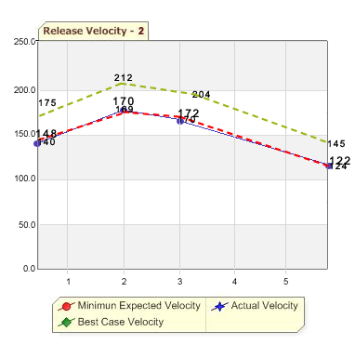
Velocity Chart

Slide 13

Iteration Burnup
This view of project velocity may also be referred to as the “cumulative flow” of the project.
The value-centric nature of ABP suggests that this model could easily be extended to facilitate Earned Value Analysis.
The project is not doing good because of many reasons e.g. the project is suffering from scope creep and low productivity/bad planning.

Slide 14
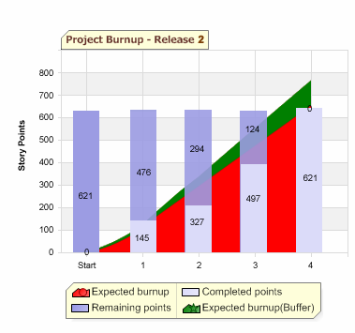
Iteration Burnup Chart

Slide 15
Iteration Burndown
A tracking tool that measures the progress a track is making in each iteration
Hours is the unit of measure used in the Daily Burndown
As stories are completed, the total outstanding story points for the iteration decreases - this is updated when team members update the Iteration Plan

Slide 16
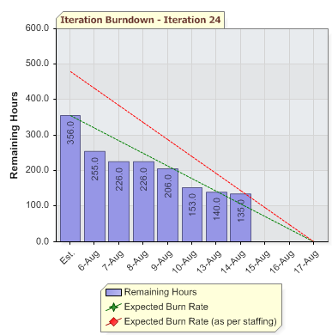
Iteration Burndown

Slide 17
Collect Client Feedback
Purpose:
  To Solicit, Collect, Store and Communicate Client Feedback
Objective:
  To identify our strengths and weaknesses in the delivery of projects
Activities:
  Collect feedback from Client using Sapient Client Feedback Form:
    Create Projects At the end of each Release
    Manage Projects Half-yearly or Quarterly, as agreed upon with Client
  Report results to BU Leadership and Marketing
  Submit the completed Feedback Form in Pyramid or on the Intranet
Mandatory Artefact:
  Sapient Client Feedback Form

Slide 18
Close Project
Purpose:
  To ensure that final deliverable, administrative, and knowledge management activities are completed before the team is reassigned
Objective:
  The Project team ensures that:
    The Clients receive everything they expect
    Project knowledge can be reused and easily shared
    Miscellaneous administrative tasks which might damage the Client Relationship are not forgotten
Activities:
  Conduct a formal debrief with the Project Team
  Conduct the Closure Audit using the Closure Audit Checklist
  Collect Client feedback and submit it in the Pyramid
  Collect and scrub Project assets
  Make sure that all the invoices are billed and paid
Mandatory Artefact:
  Closure Audit Checklist
  Project Debrief Presentation submitted to S|A Team

Slide 19

Questions?

